Slide 1
Introduction program
In python

Slide 2
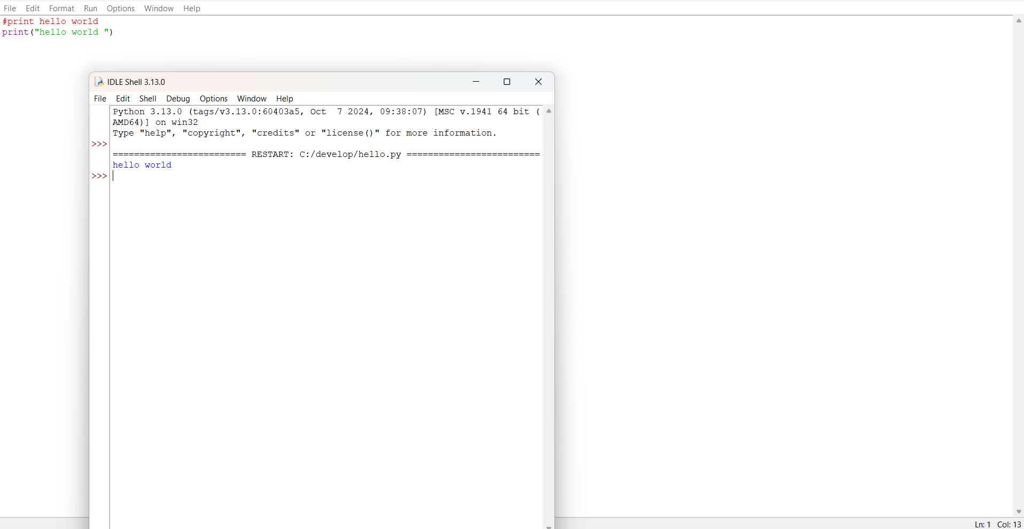


Slide 3
